Slide 1
Java RMI

Slide 2
What is RMI?
RMI is an RPC system for an object based language.
Objects provide a natural granularity for the binding of functions.
  RMI allows a program to hold a reference to an object on a remote system and to call that object’s methods.
Client-Server architecture.
  Server holds the object.
  Client holds a small stub that accesses the object on the Server.

Slide 3
Remote Objects
What can be accessed?
  Class must be designed to be remotely accessed:
    It must implement the Remote interface
    Usually extends one of the RMI communication classes (if you need your own client-server protocol or want to run some methods on the client, you can write your own).
  Function calls only (not fields)
  All methods throw a RemoteException

Slide 4
Classes
Interface
  An interface containing all of the functions to export
Implementation
  An object implementing this interface on the server
Stubs
  Client-side object that implements the interface and communicates with the server object. Automatically generated using the ‘rmic’ command.
Skeleton
  Server-side object that listens for remote requests and calls the implementing class. Handled automatically by Java 2.

Slide 5
Parameter Passing
Call by reference if the parameter implements Remote
  An instance of the Stub object is created, serialized, and sent to the client.
    If the client does not have the actual Stub code, it is downloaded from a web server.
  Reference server object is leased by the client. Server object not garbage collected until no references remain.
Call by value otherwise
  Implemented through serialization (Java makes marshalling fairly simple) .

Slide 6
Define the interface
public interface GlobalMap extends Remote
{
public void put(String key,Object data)
throws RemoteException;
public Object get(String key)
throws RemoteException;
}

Slide 7
Implement the interface.
public class GlobalMapImpl extends UnicastRemoteObject
implements GlobalMap {
private Map m;
public void put(String key,Object data) throws RemoteException {
m.put(key,data);
}
public Object get(String key) throws RemoteException {
return m.get(key);
};
public GlobalMapImpl() throws RemoteException {
m=Collections.synchronizedMap(new HashMap());
}
public static void main(String[] args) throws Exception {
GlobalMapImpl gm=new GlobalMapImpl();
Naming.rebind("GlobalMap",(Remote)gm);
}
}

Slide 8
Use the interface
public class MapClient {
public static void main(String[] args) throws Exception {
System.setSecurityManager(new RMISecurityManager());
GlobalMap gm=(GlobalMap)Naming.lookup("GlobalMap");
try {
if (args[0].equals("put")) {
gm.put(args[1],args[2]);
} else if (args[0].equals("get")) {
Object obj=gm.get(args[1]);
System.out.println("Got :"+obj);
}
} catch (RemoteException re) {}
}
}

Slide 9
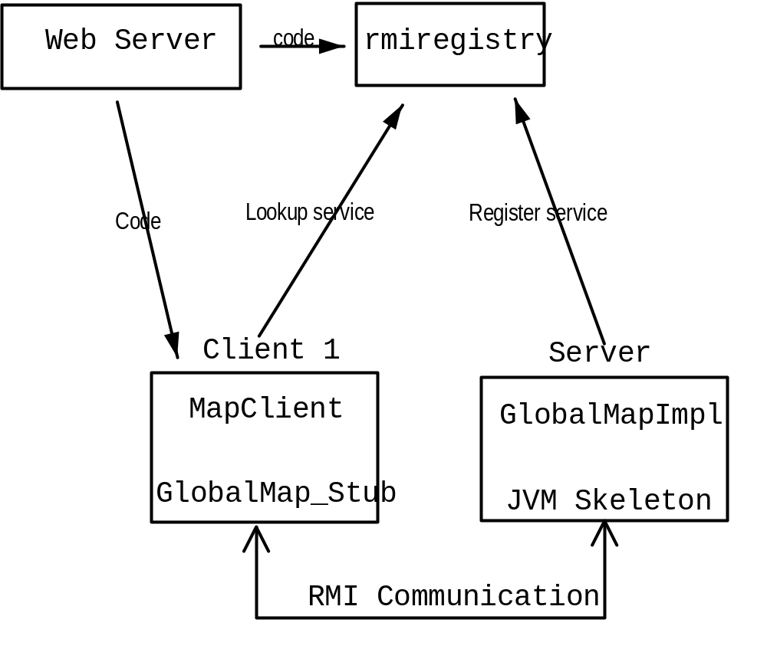
Sample app overview

Slide 10
Compiling the Server
Compile the interface and implementation normally.
Create the stub file using:
  rmic –v1.2 GlobalMapImpl

Slide 11
Compiling the client
Need access to the GlobalMap.class file, but NOT the implementation file.
Compile normally.

Slide 12
Running the server
Copy the remote object .class files to a web server (Jini includes a simple one).
  You should only need the interface and the stub files on the web server.
Create a file named policy.all with the following:
  grant {
  permission java.security.AllPermission "", "";
  };

Slide 13
Running the server
Run the rmiregistry service so the client can find the remote object.
  CLASSPATH should NOT contain the class files.
  Run:
    rmiregistry
Run the server
  CLASSPATH must include the implementation class.
  In another shell, run:
  java –Djava.security.policy=policy.all –Djava.rmi.server.codebase=http://XXX/ GlobalMapImpl

Slide 14
Running the client
Run the client
  java –Djava.security.policy=policy.all –Djava.rmi.server.codebase=http://XXX/ MapClient put key data
What does the command line mean?
  –Djava.security.policy=policy.all
    Lists the security restrictions on code. At the very least Stubs need access to the network.
  –Djava.rmi.server.codebase=http://XXX/
    Tells where to find the stub for any Remote objects I’m exporting.

Slide 15
A more interesting client
ChatClient uses GlobalMap as a lookup service.
  The “Listen” client registers a name in the map
  The “Send” client queries the map for the Listener. Sends a message to the Listener.
public interface ChatClient extends Remote {
public void notify(String str) throws RemoteException;
}

Slide 16
public class ChatClientImpl extends UnicastRemoteObject
implements ChatClient {
public void notify(String str) throws RemoteException {
System.out.println("Got a message:"+str);
}
public static void main(String[] args) throws Exception {
System.setSecurityManager(new RMISecurityManager());
GlobalMap gm=(GlobalMap)Naming.lookup("GlobalMap");
if (args[0].equals("listen")) {
gm.put(args[1],new ChatClientImpl());
} else if (args[0].equals("send")) {
Object obj=gm.get(args[1]);
ChatClient ch=(ChatClient)obj;
ch.notify(args[2]);
}
}
}

Slide 17
Activation
So far, objects are instantiated all the time.
  Want to register services that won’t often be used.
  Don’t want to restart all services whenever we reboot
rmid
  Starts other servers on demand (like inetd on unix)
  Registration is persistent

Slide 18
Activation
Coding changes:
  Extend Activatable
  Create a new constructor with ActivationId and MarshalledObject parameters.
  Create an ActivationGroup containing information to start the server(policy file, class name, etc)
  Register rmid with rmiregistry

Slide 19
Other issues
Server must call inactive() to signal it is willing to terminate.
  Can terminate even if there are remote references if there are no ongoing operations.
Must deal with saving our state.
  When we are made inactive, current state is not saved.
  Application must store their state somewhere and know where to find it when they returns

Slide 20
Running it
Start rmid
  rmid –J-Dsun.rmi.activation.execPolicy=none
    This gives you the same level of security listed in the Jini book. To learn more about the new security model, see: http://developer.java.sun.com/developer/products/jini/execpolicy.html
  This creates a directory named ‘log’ in the current directory which holds persistent state.
Start the server
  Java –Djava.rmi.server.codebase=http://XXX/ -Djava.security.policy=policy.all GlobalMapImpl http://XXX/ policy.all

Slide 21
Security
A lot of issues
  How should we limit who can register?
  What permissions should downloaded stubs have?
  How should we authenticate stub/server connections?
Most of these are unsolved (or at least unimplemented) issues in Java.

Slide 22
Sample Code
The code for these slides (as well as code for an Activateable version of the server) is available at:
  http://www.cs.washington.edu/elemar/rmi.tgz
The Jini book also has a reasonable RMI tutorial.

